Slide 1




DWH, ETL, Agile & Testing
Fundamentals

Slide 2


Data warehouse concepts
01
DAY
20-February-2023
DWH Architecture
Data Models
Dimensions
Facts & Schemas
DWH Introduction
07
08
09
February

Slide 3

ETL & BI
02
DAY
21-February-2023
ETL Requirements
Introduction to BI
Need for BI & BI Layers
08
09
10
February

Slide 4

Project Management
03
DAY
22-February-2023
Human Centered Design Thinking
09
Introduction to Project Management
10
Project Planning
11
Project tracking and monitoring
Risk Management
February

Slide 5
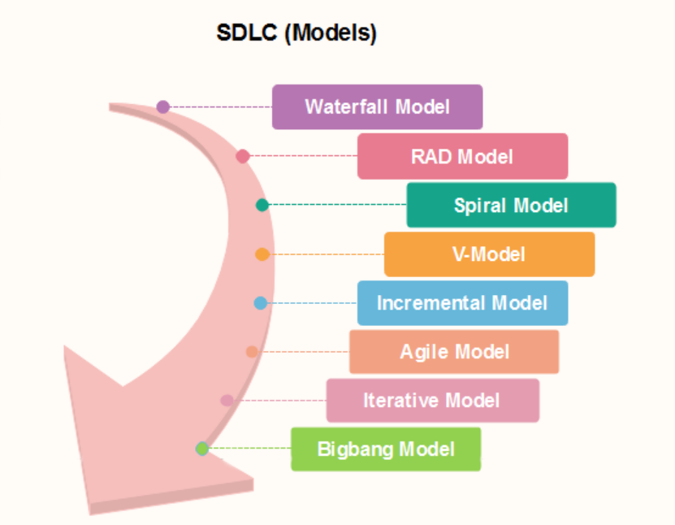
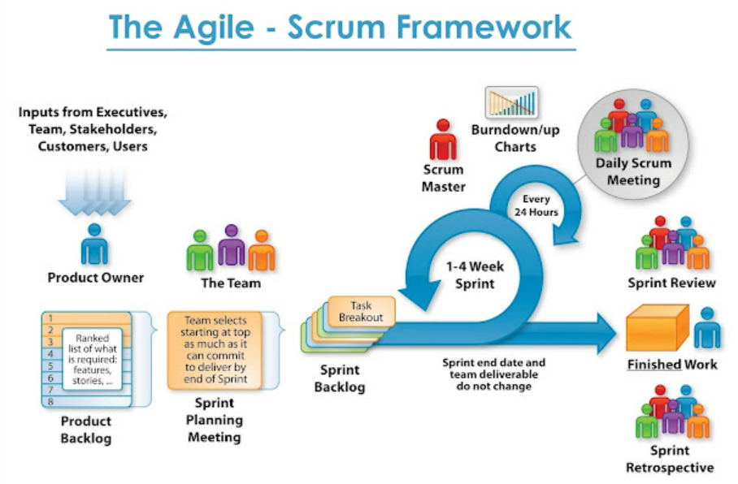
Agile & SDLC
23-February-2023
04
DAY
10
11
12
February

Slide 6
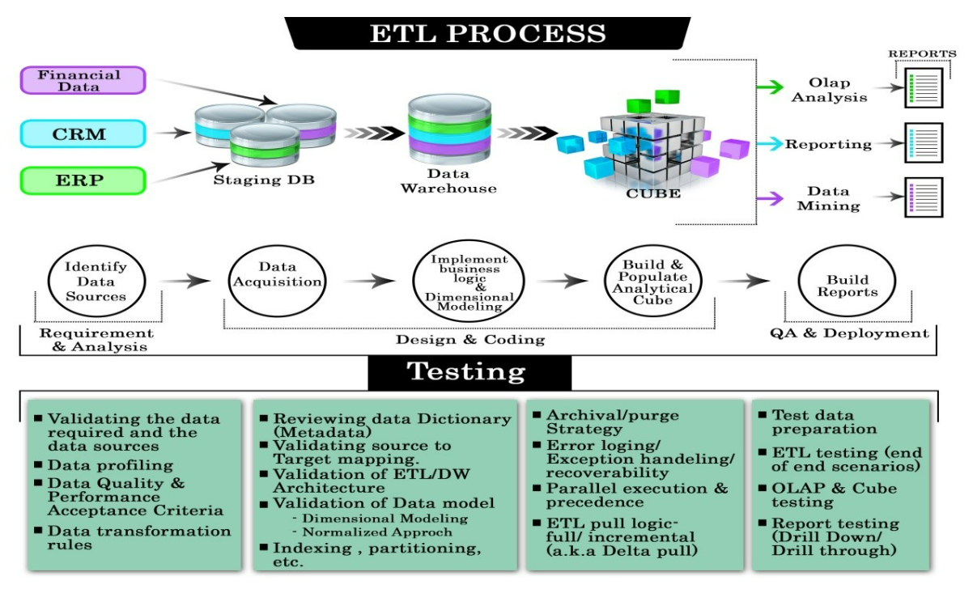
Testing
05
DAY
24-February-2023
ETL Testing
Types of Testing
11
Automation Testing
12
Mannual Testing
13
February

Slide 7
THANK YOU

